Slide 1
Bank Term Deposit Case Study for Quicken Loans
March 18th, 2021
Presenter: Jamie Stewart

Slide 2
Case Study Overview
A European banking institution is attempting to use some data to understand what factors could lead more of its customer base to subscribe to its term deposit product through a marketing campaign.
Data is included about the person, contact timing, credit history, and broader social and economic factors.
Data also includes whether the caller subscribed to the deposit, and the current model’s probability prediction that a caller will subscribe to a term deposit.

Slide 3
Case Study Presentation Overview
Key data insights
Review of data cleaning methods employed
Evaluation of the current model
Precision and recall: true and false ‘yes’ rates
Development and implementation of new models
All variables, then fewer variables excluding protected classes
Recommendation on whether the current model be replaced

Slide 4
Key Data Insights
Imbalanced data show that only 11.3% of customers campaigned subscribe to term deposits.

Slide 5
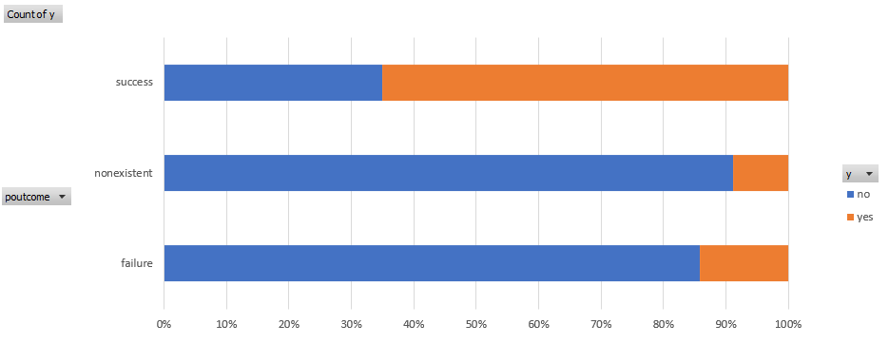
Key Data Insights
A successful outcome of the previous marketing campaign is associated with future success. However, less than 5% of customers have a prior success.

Slide 6
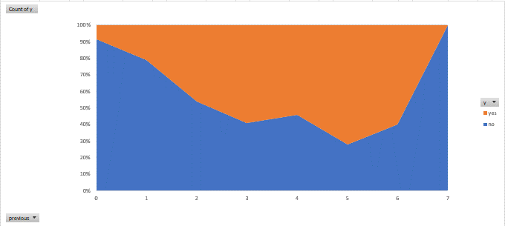
Key Data Insights
The ‘yes’ subscribers exceed ‘no’ subscribers when contacted at least 3 – 6 times prior to this campaign.

Slide 7
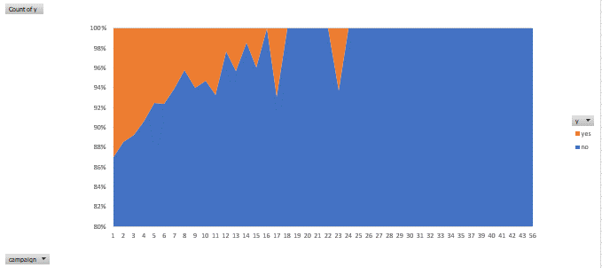
Key Data Insights
When it comes to number of contacts within the given campaign, less is more.

Slide 8
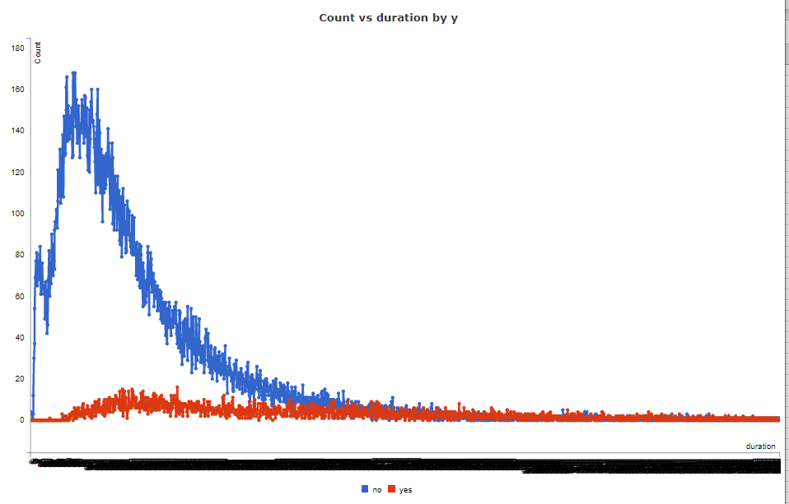
Key Data Insights
Discuss why “last contact duration” is a benchmark and not an input variable.

Slide 9
Key Data Insights
Generally, the lower the employee variation, consumer confidence index, and Euribor 3-month rate, the more ‘yes’ subscriptions.
A higher percentage of those aged under 23 and over 61 have a higher percentage of term deposit subscriptions than those aged 24-60. However, most individuals in the campaign are aged 24-60.
What are bank term deposits?

Slide 10
Data Cleaning Methods
Python programming methods are employed for data cleaning
Data contain no blanks, and “unknown” values in the data are kept intact.
Numerical columns like age, number of contacts per campaign, number of days since last contact, and social and economic factors are scaled to be more normalized.
Categorical columns like job, education, credit variables, etc. are transformed into a numerical format the model will accept.
Example: The marital status column is split into separate columns marital_married, marital_divorced, etc. with yes coded as 1, and no coded as 0.

Slide 11
Data Cleaning Methods
All column names are updated to replace dashes and periods with underscores.
Example: The education_high.school column is updated to education_high_school with the period removed.
The column indicating whether the caller subscribed to a term deposit or not, has data transformed from ‘yes’ to 1 and from ‘no’ to 0.
The duration of call and ModelPrediction columns are both dropped from the data.

Slide 12
Evaluation of the Current Model
Model Performance is defined as results from a current model used to predict whether a client will subscribe (‘yes’) to a term deposit (probability of subscribing to term deposit).
Initially, the current model does not look like a promising predictor at first glance:
Average number of callers that do subscribe to a deposit: 11.3%
Average number of callers the model predicts will subscribe to a deposit: 88.7%.
Let’s take a closer look at the current model’s predictions.

Slide 13
Evaluation of the Current Model
The existing model uses probabilities, or likelihoods, that a caller will subscribe ‘yes’ to a term deposit.
The column that the existing model attempts to predict, has a clear yes or no response.
How should the existing model of percentage likelihoods be evaluated against whether a caller subscribes (yes/no)?
For simplicity, first convert all current model probabilities:
50% and above are converted reflect a yes.
Less than 50% are converted to reflect a no.

Slide 14
Evaluation of the Current Model
Though some meaningful information is lost in the transformation, the simplicity facilitates an easier comparison of the ‘yes’ rate and ‘no’ rate of the model’s predictions against the actual ‘yes’ and ‘no’ rate of subscribers.
Proxy for accuracy score: 10%
Of all the predicted ‘yes’ subscribers, how many of those were actually ‘yes’ subscribers? 10% (aka “precision”)
Of all the ‘yes’ subscribers, how many were we able to correctly predict as being ‘yes’ subscribers? 85% (aka “recall”)
Of all the ‘yes’ subscribers, the model is able to predict most of them correctly.

Slide 15
Recommendation on Current Model Replacement
Though the current model captures 85% of all ‘yes’ subscribers as being predicted as a ‘yes’ subscriber, 90% of the model’s predictions think the caller will subscribe when the caller does not.
I would recommend a model that continues to capture the highest percentage of ‘yes’ subscribers in its predictions, relative to while reducing the number of false predictions that a caller with subscribe to a term deposit when it will not.
It also seems more likely that the model is predicting ‘no’ subscription rates, rather than ‘yes’ subscription rates.
Notes:
Mathematically speaking, Recall for this situation is more important than precision. F1 harmonic mean seeks to balance precision and recall, but in this situation, I would maximize recall in relation to the inverse of precision.

Slide 16
New Model Experiments
I designed and deployed new predictive models with the data provided.
Both models, Naïve Bayes and Logistic Regression, are known for being relatively explainable, simple, and produce likelihoods of a caller saying ‘yes’ to a term deposit.
Both proposed models are strong predictors for problems like this one.
The performance measure utilized for the new models is a more complex version of what was leveraged to evaluate the current model against the actual subscriptions.

Slide 17
New Model Experiments
Both Naïve Bayes and Logistic Regression performed relatively well using Area Under the ROC Curve as a performance metric. However, Logistic Regression performed better.
AUC for Naïve Bayes: 76.84%
AUC for Logistic Regression: 79.18%
A second iteration of the models was deployed with the protected classes of age and marital status removed, with little impact to performance.

Slide 18
Questions and Additional Discussion

